Slide 1
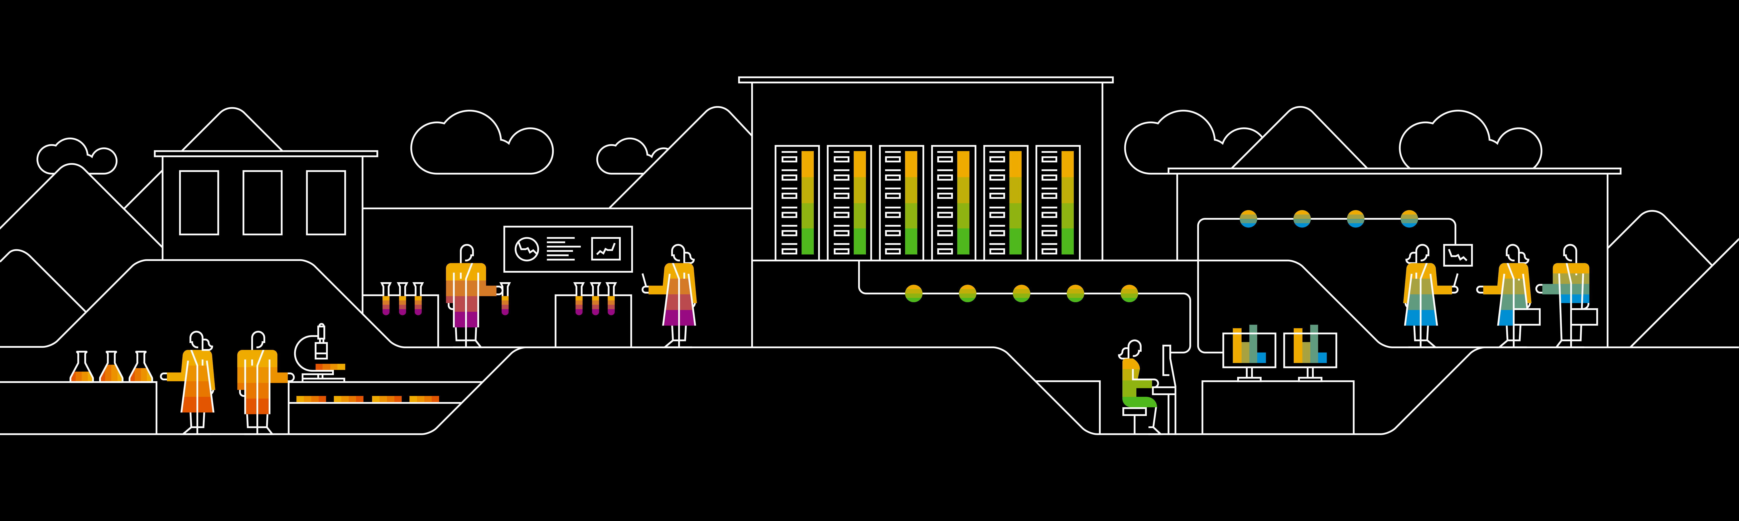
Introduction to Lean Kanban systems
Agile & DevOps Competency Center, SAP
April 08, 2019

Slide 2
Agenda
Background
Kanban and theories behind
Context switching
Little’s law
Theory of constraints
Feedback loops
Kanban principles
Visualize work
Limit WIP
Manage flow
Everyday Kanban

Slide 3
Background

Slide 4

What does Lean mean?
1
2
3
Reduce waste
Increase efficiency
Eliminate bottlenecks
This makes abundant sense for a repetitive, repeatable process
This is typically achieved by buying newer, more up to date machinery
This is achieved by restructuring the manufacturing workflow

Slide 5

Kanban principles
01
Identify potential for improvement
The ”reduce waste” concept in software development is evolved to do not just tackle repeatable steps but automate repetitive and eliminate steps or items that does not add value
02
Increase efficiency
On software development, this principle focuses on improving the process, rather than the people.
03
Eliminate bottlenecks
This evolves identifying steps in the software development process where work that needs attention is queuing up to too great a volume for the work to keep flowing smoothly.

Slide 6
Kanban and the theory behind it

Slide 7
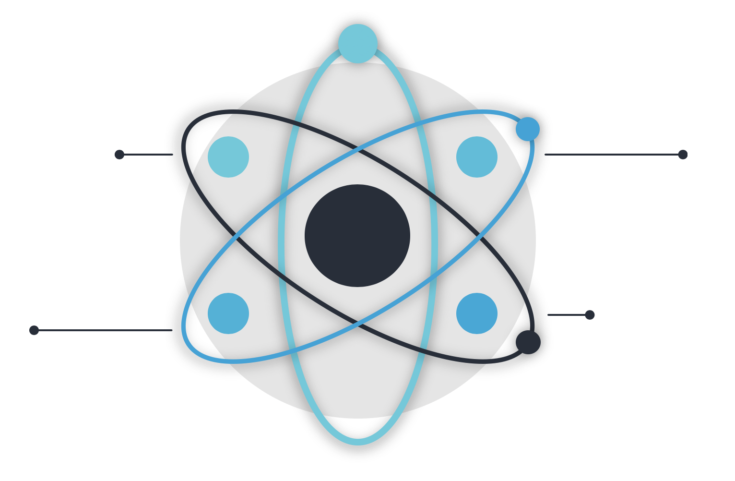
Theories behind it
Context Switching
Theory of Constraints
Public enemy #1 in creative work. “One thing at the time” is most effective
“ A chain is not stronger than it’s weakest link “
Feedback Loops
Little’s Law
Feedback is the creator of knowledge. As short feedback loop as possible.
Cycle time = Work in process / throughput

Slide 8
Kanban Principles

Slide 9
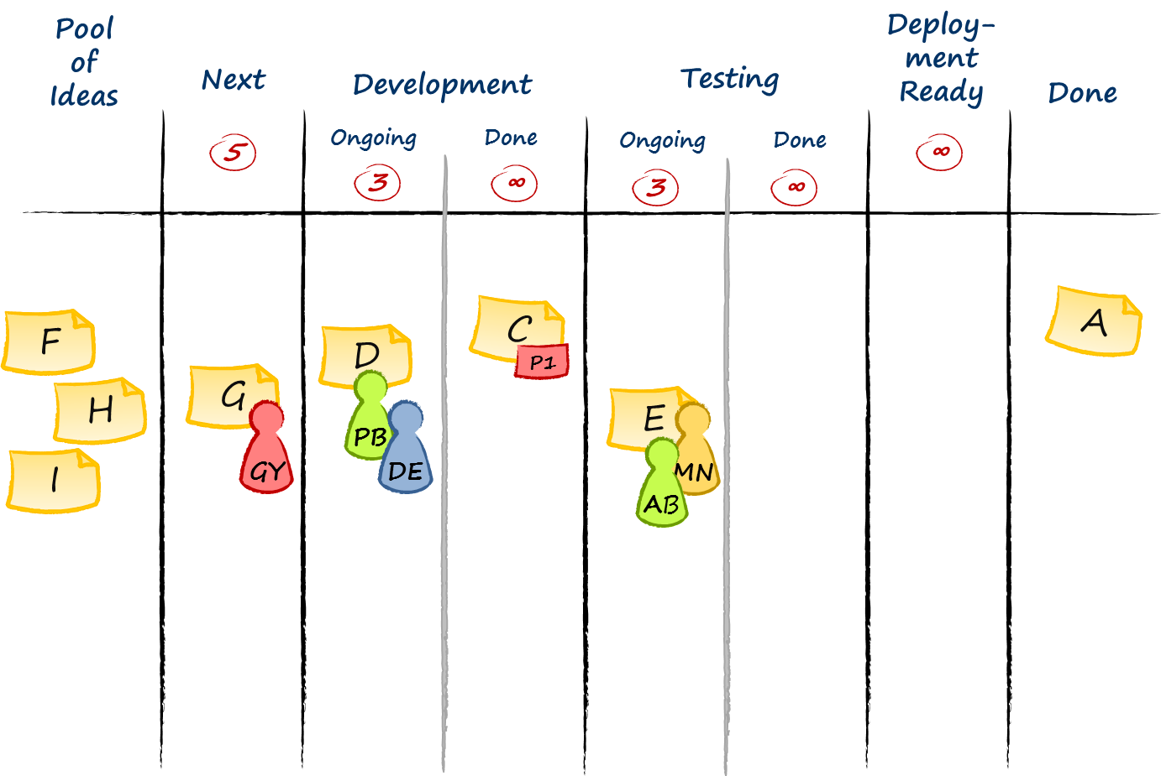
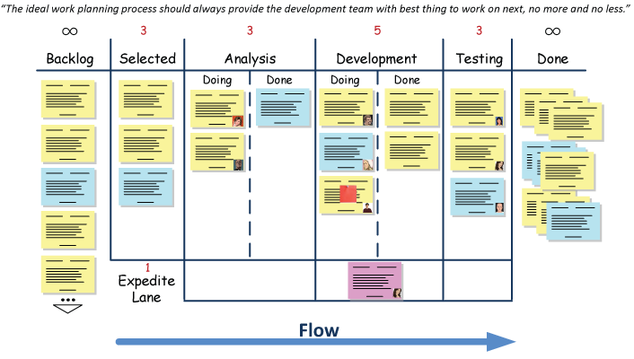
Visualize
Kanban board – whiteboard or other empty wall space
Columns represents steps in work process
Work tasks represented by cards or stickies
How to find columns? Dry-run a few tasks through your work process
Avatars
Explicit policies

Slide 10
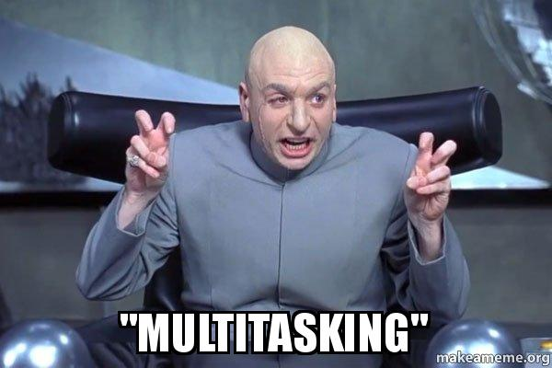
Limit WIP
WIP means all the work that you have going on right now. From commitment point until delivery point.
Limit WIP to secure flow
Set WIP limit – pick a number and try it out ( then learn and adjust )
WIP per column. Avoid per whole board as least initially. Based on the processing time of each time.
Stop starting, start finishing!

Slide 11
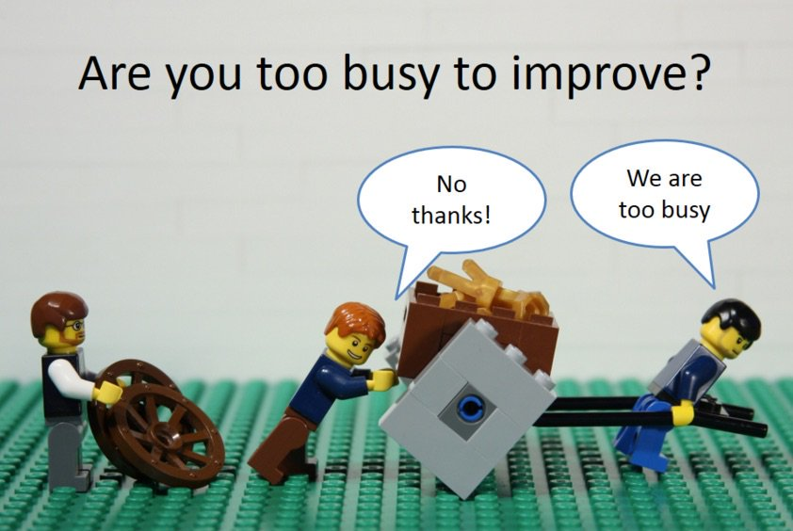
Manage flow
Flow is when each part of the work moves from one value adding step to another without any waiting times or delays
Limit WIP
Remove blockers ( swarming )
Continuous improvement – real purpose of Kanban
Retrospectives
Root-cause analysis
Improvement Kata ( Toyota )

Slide 12
Everyday Kanban

Slide 13
“Stop starting
and start finishing!”
Common sense

Slide 14
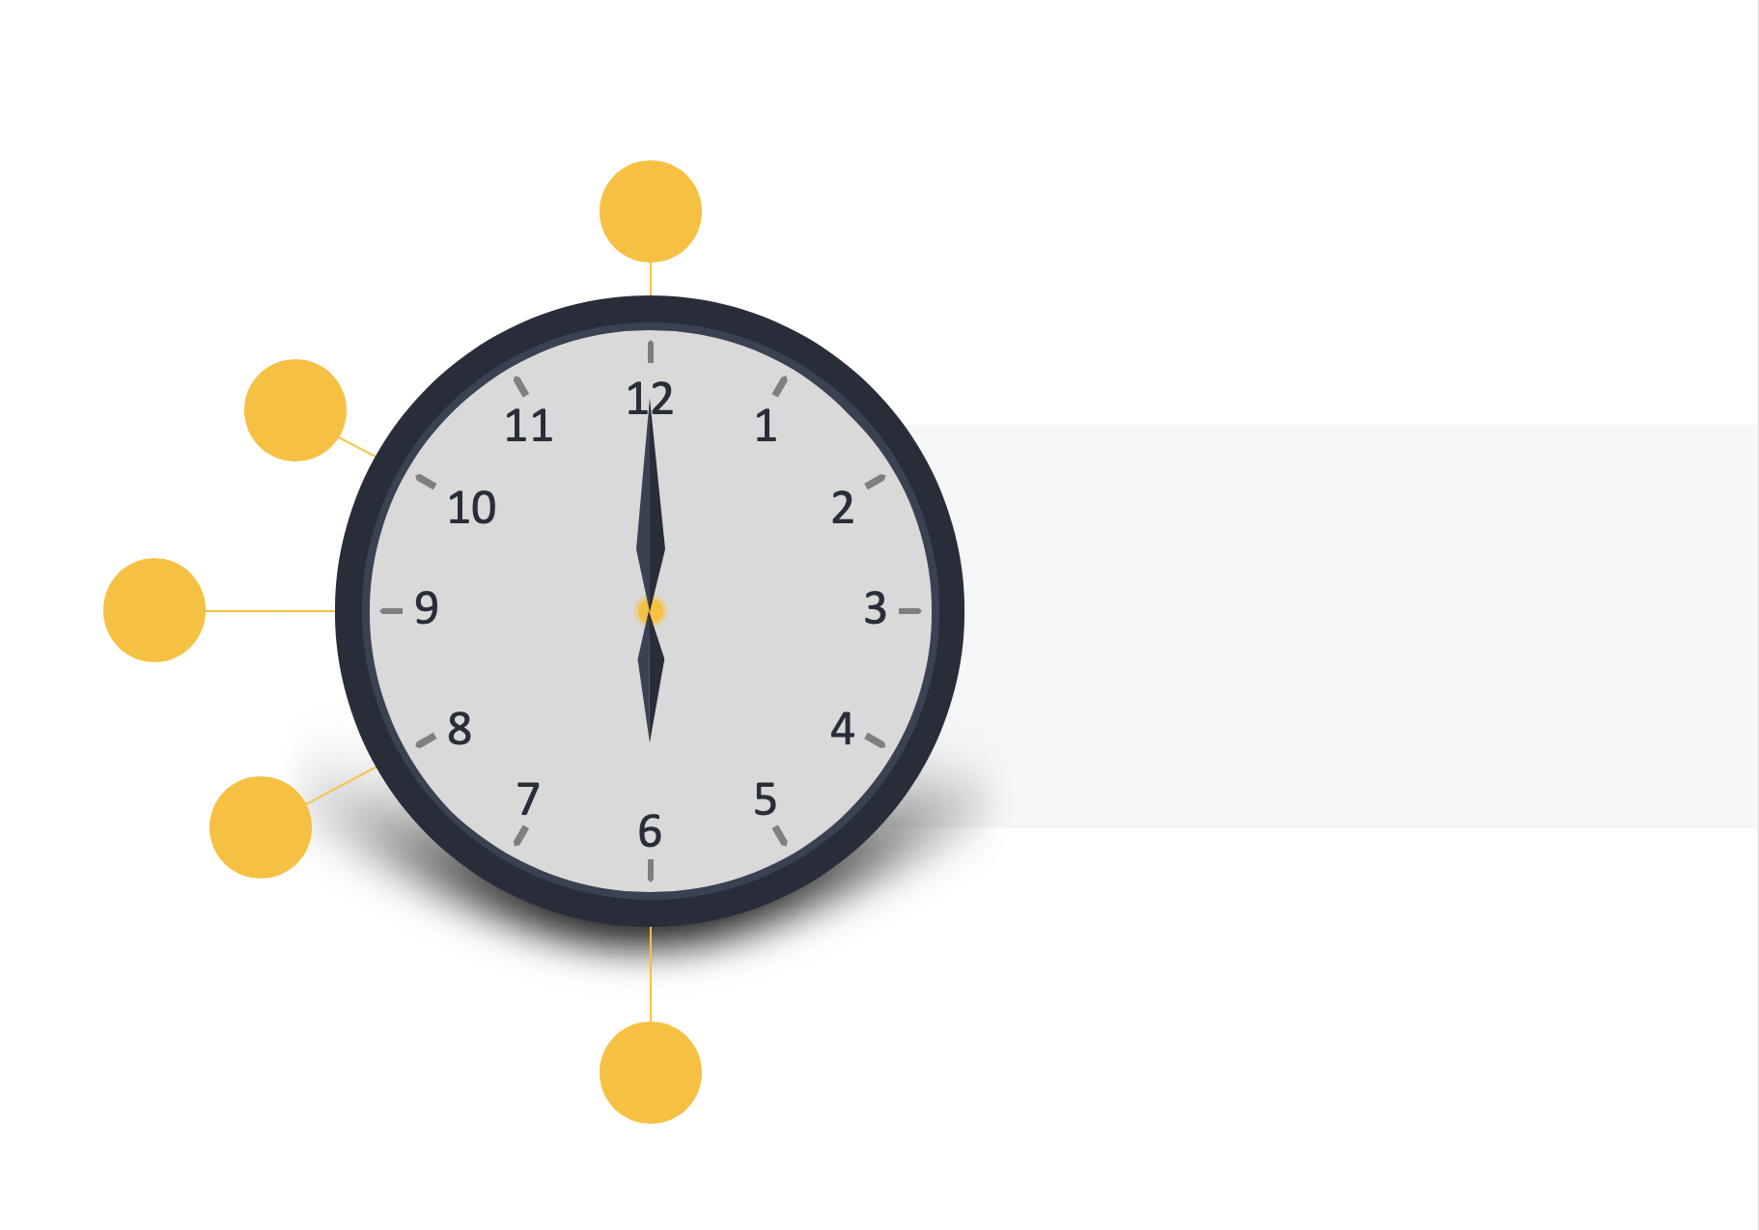
Where to start?
Start with that you do now
You can overlay Kanban properties on top of your existing workflow or process to bring your issues to light so that you can introduce positive change over time.
Agree to pursue incremental, evolutionary change
The Kanban method is an approach to change management that is designed to meet minimal resistance. Therefore it encourages continuous small incremental and evolutionary changes to your current system.
Respect the current process, roles, responsibilities & titles
You have existing pieces in the way you do what you do that are working properly and worth preserving. Kanban doesn’t prohibit change, but it doesn’t prescribe it either. If you do make changes, Kanban encourages incremental change.
Encourage acts of leadership at all levels
Some of the best leadership comes from everyday acts from people on the front line of their respective teams. Everyone needs to be fostering a mindset of continual improvement (kaizen) to reach your optimal performance as a team/department/company.
Improve collaboratively
The Kanban method suggests that a scientific approach is used to implement continuous, incremental and evolutionary changes
Notes:
The Kanban method does not prescribe a certain setup or procedure. You can overlay Kanban properties on top of your existing workflow or process to bring your issues to light so that you can introduce positive change over time. This makes it very easy to begin a Kanban implementation as you do not have to make sweeping changes
Kanban recognizes that there may be value in the existing process, roles, responsibilities, & titles. You have existing pieces in the way you do what you do that are working properly and worth preserving. Kanban doesn’t prohibit change, but it doesn’t prescribe it either. If you do make changes, Kanban encourages incremental change. Incremental change doesn’t create the level of fear that impedes progress, which allows you to generate broader support for your Kanban implementation. It also makes it easier to implement Kanban. Small course corrections are also just inherently easier than altering the complete process.

Slide 15
Cadences
Not too prescriptive on “ceremonies”
The Kanban system is composed by 7 non mandatory “cadences”, in which 4 are reviews and 3 are checkpoints or sync up meetings. All of them with goal to validate experiments and define actions based on data. Here are listed the more important :
1
2
3
Replenishment
aka ’4 Rs’
Daily sync
Service Delivery Review
Review ( including demo, if possible
Risks
Retrospective
Refresh backlog
Walk the board right to left and top to bottom
Any other business (AOB )
Optional daily demo
Examine and improve the effectiveness of a service, analyzing the latest weeks deliveries

Slide 16
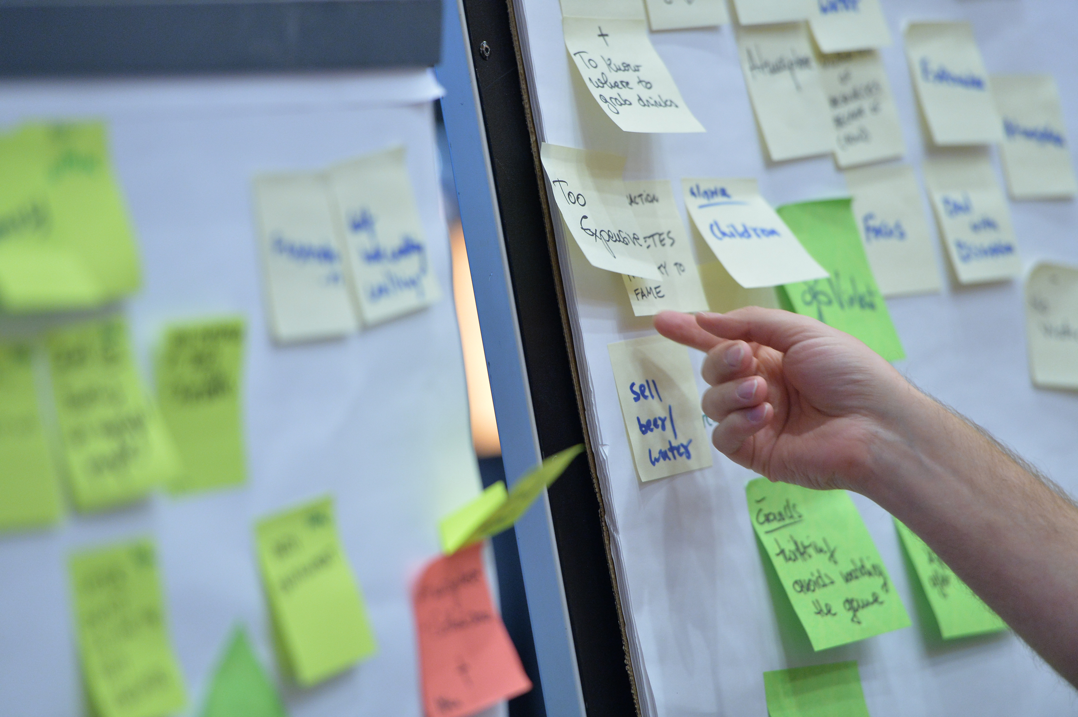



Designing the board
01
02
03
04
Visualize and map the flow of work
Set initial limits on your work in progress
Get your works in progress on the board
Inspect and adapt, then improve
Notes:
You have to visualize and map out the process that is being followed to complete work. This will give you – and everyone in the organization, not just the members of the team – more than a glimpse of the whole process. This way, they will be knowledgeable about all its aspects, so they can contribute more. This will also be useful in monitoring the progress of work of a team.
Use kanban cards or sticky notes to represent the work that will be done. If the processes are simple enough, mapping it out should be just as simple, with straight vertical lines down the board. However, in the event that the processes are quite complex, it may require both vertical and horizontal lines, often intersecting each other at some points.
We have mentioned earlier that one of the benefits of using the Kanban method is that work in progress becomes limited. When designing your kanban board, you have to set initial work in progress limits, meaning, at any point in time, the “CURRENT”, “WIP”, “IN PROGRESS” or “IN WORK” section (depending on what title or label you have chosen) should have only a maximum number of sticky notes.

Slide 17
“It’s great for service delivery. It’s antifragile too!”
No one

Slide 18
Thank you.
Contact information:
Agile & DevOps Competency Center
Jam
Email

